Slide 1


Programming Language Diversity and Software Growth: A Case Study
Samuel Barrett, Oscar Sandford, Natasha Bansal, Kenil Shah

Slide 2


Slide 3
T & G Methods
01
02
03
MOTIVATION
METHODS
FINDINGS

Slide 4

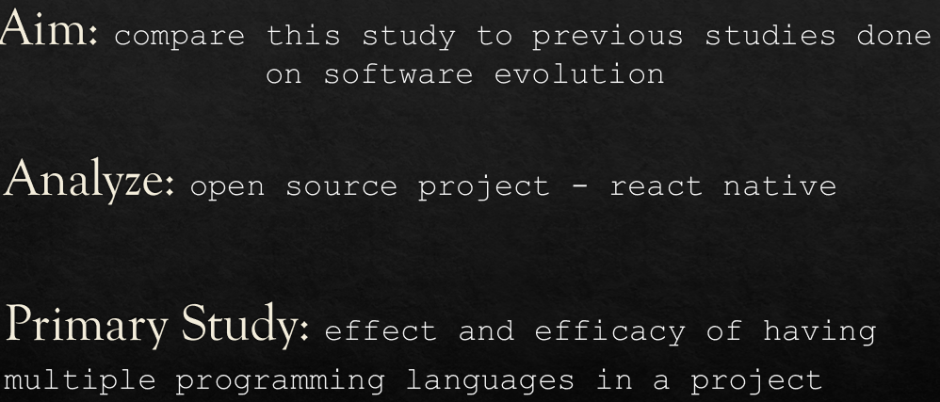

Slide 5

Motivation
What motivates the need for more than one language?
In what subsystems are the languages used and does this lead to less manageable complexity?
How much open source development has changed between Linux then and React native now?

Slide 6

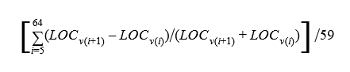
Methods
data - GitHub repository for React native
define - subsystem hierarchy for React native
use of cloc - gathered data for 37 subsystems across 59 versions
Our metric is defined as follows:

Slide 7

Findings
calculated the growth metric for each subsystem
plotted it against the average number of languages across all versions of React native for each subsystem
10% of subsystem growth rate is due to the number of languages used.
subsystems with more languages grow faster instead of slower

Slide 8
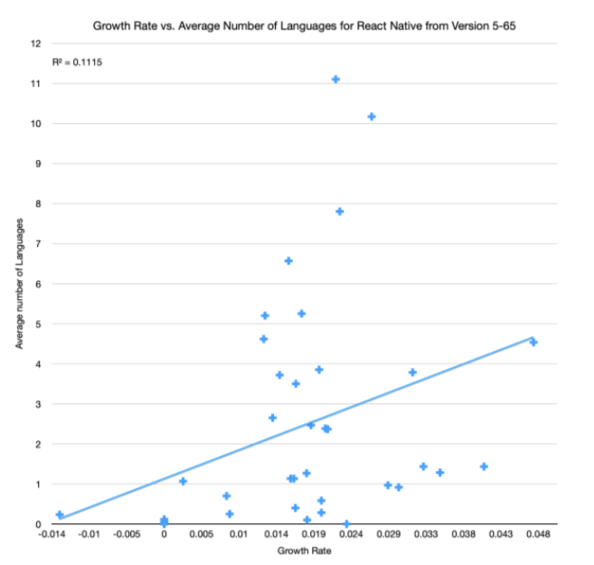

Slide 9


Slide 10
Conclusions
subsystems with more languages are developed more often, as they may be core components
linked spike in growth of some of React Native’s key subsystems around release 59 - Libraries and React Common
LOC growth of React common and library subsystems - growth of one is dependent on the other
core subsystems have a tendency to cause growth of dependent subsystems like libraries

Slide 11
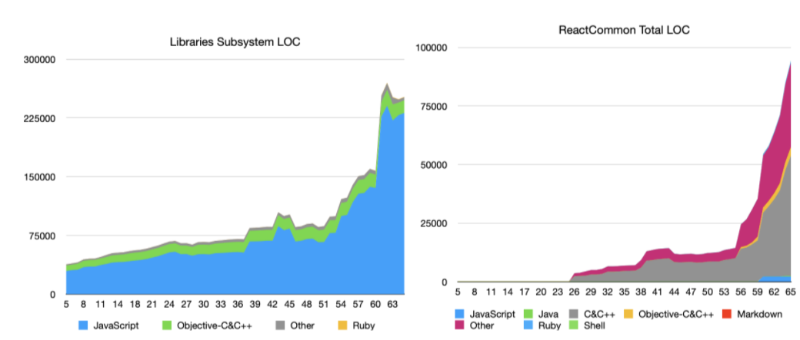

Slide 12


Slide 13

Language Diversity
Some language-diverse subsystems evolved at a slower rate.
React android - growth patterns are not influenced by core components of systems such as React common
React Native- naturally driven growth of a cross-platform framework
Further research is needed across other OSS projects with similar language diversity

Slide 14
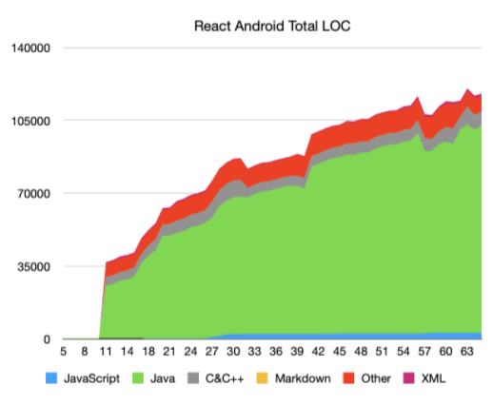

Slide 15
Implications and Further Study
Highly language-diverse core subsystems naturally drive the growth upwards
Leading factor in said growth is the maintenance and Development of such core subsystems
Can Use the results to infer in other similar OSS projects about growth in their subsystems, but again further research beyond our case study required to make such inferences about any OSS in general.

Slide 16


